Slide 1
Combinational Building Blocks

Slide 2
Index
Building Block definition
Multiplexer
Decoders
Adders
Subtractor
Comparators
Arithmetic/Logical Unit (ALU)
Shifters and Rotators
Multiplier and divider
Floating-Point Addition

Slide 3
Building Block Definition
Combinational logic can be grouped in larger building blocks to build more complex systems
Abstraction, hierarchy, modularity, and regularity
abstract (hide) gate-level details to emphasize the function of the module (block)
hierarchically assembled from simpler components
well-defined interfaces in order to use them as a black boxes
Examples:
seven-segment display decoders (already considered)
multiplexers
decoders
arithmetic circuits
We will use many of these building blocks to build a microprocessor

Slide 4
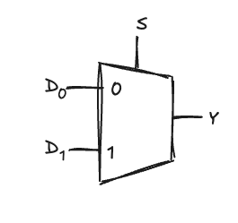
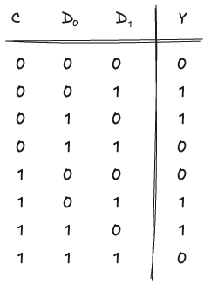
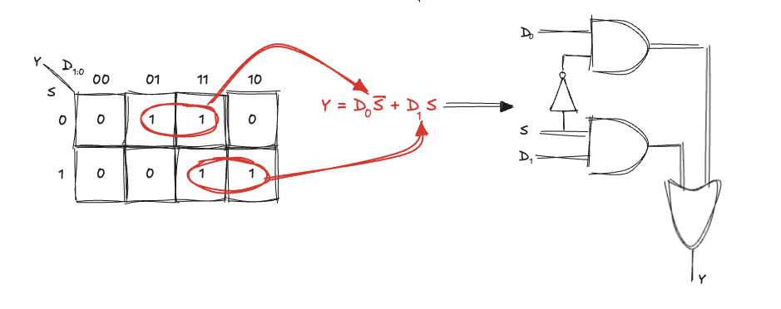
Multiplexer (mux)
A device that choose an output among several possible inputs, based on the value of a select signal
A 2:1 multiplexer has two data inputs and one output and a select signals:
if S=0, Y=D₀
if S=1, Y=D₁

Slide 5
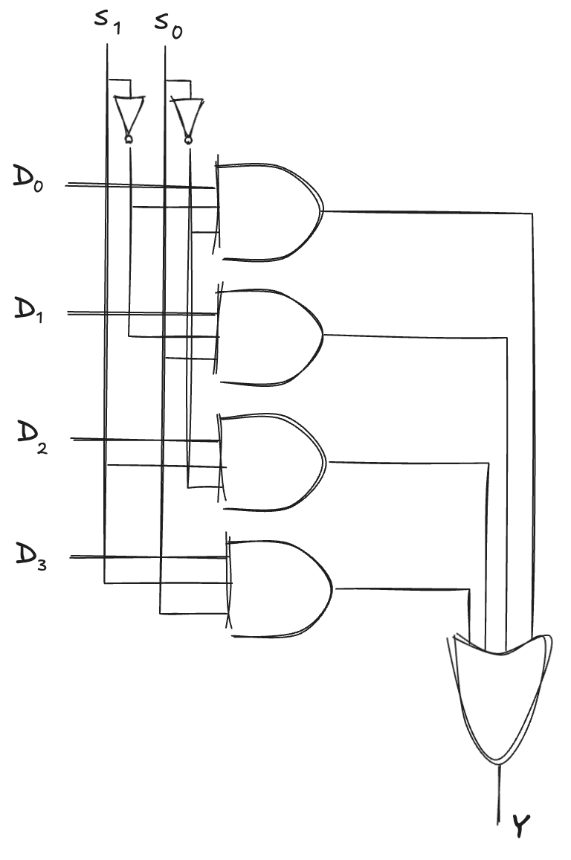
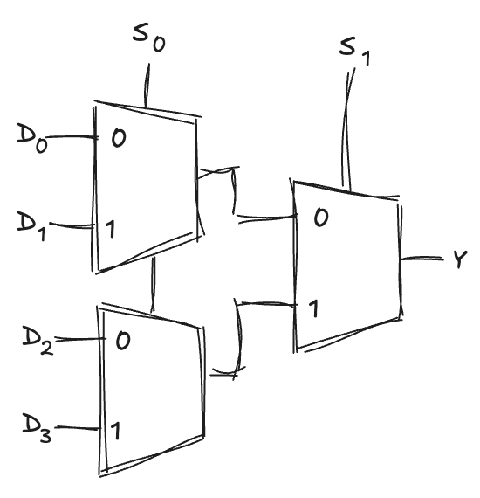
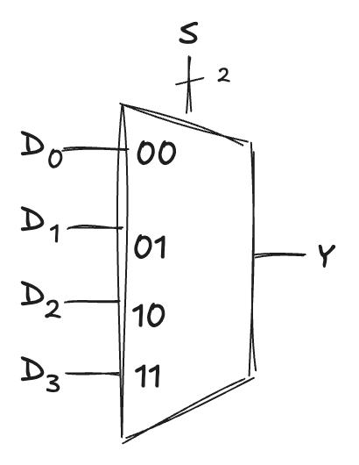
Wider multiplexer
A 4:1 multiplexer has four data inputs and one output and two select signals are needed to choose among the four data inputs
it can be built using sum-of-product logic, or multiple 2:1 multiplexers
Wider multiplexers (8:1 and 16:1) can be built by expanding the method
in general, a N:1 multiplexer needs log₂N select lines

Slide 6
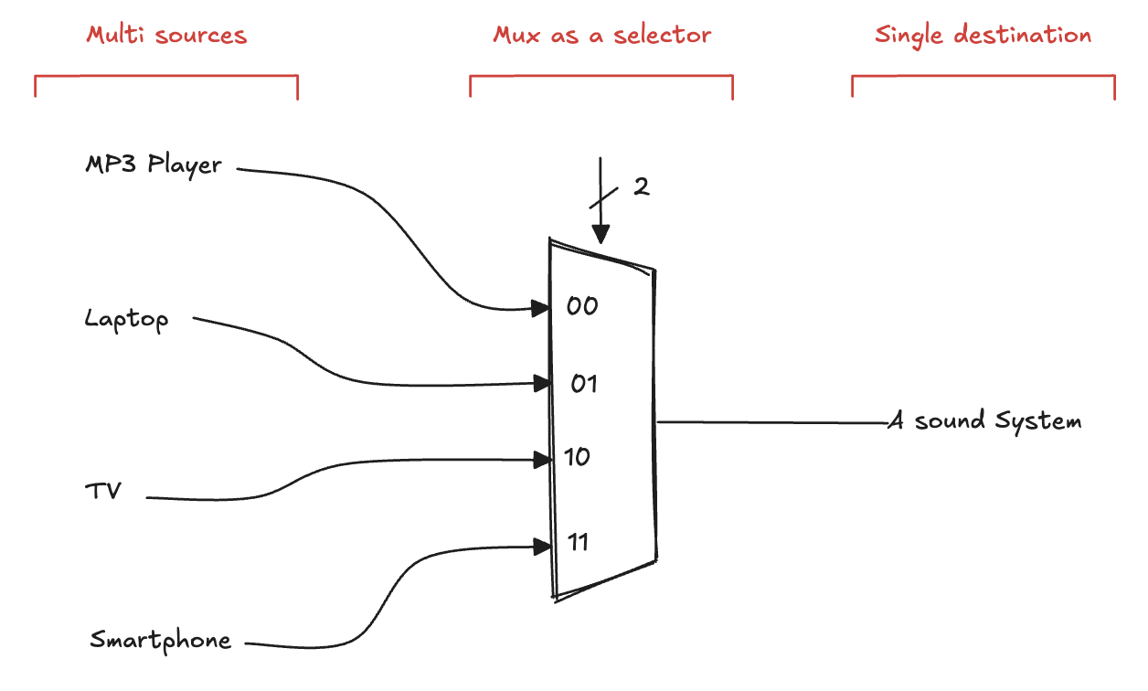
Multiplexer example
A multiplexer is like a data router: the selector determine which input data line is connected to the output, enabling efficient, sequential processing of each input

Slide 7
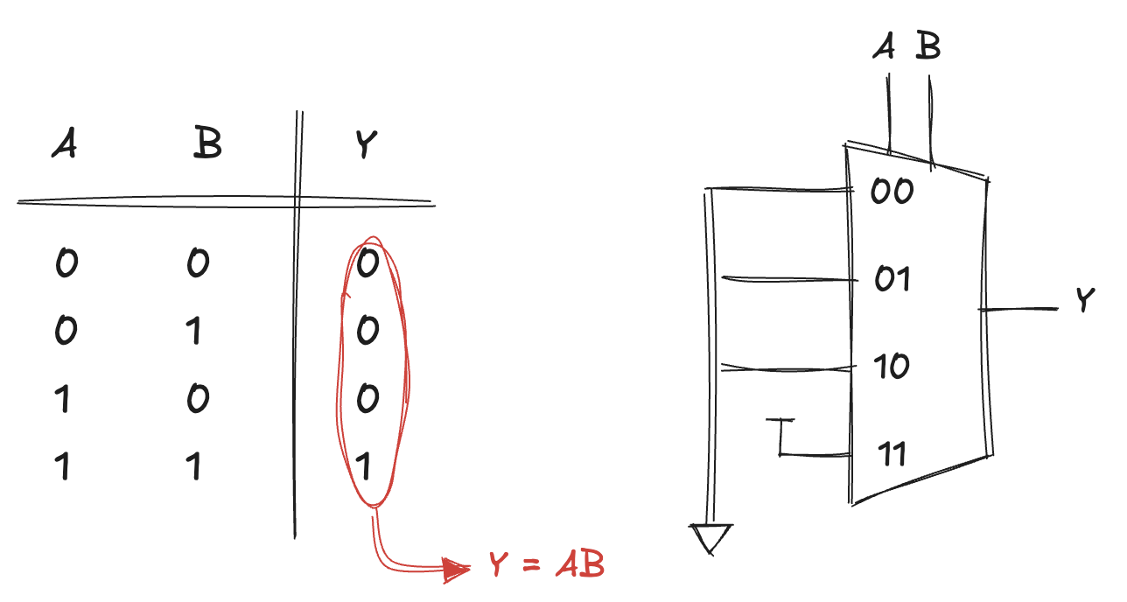
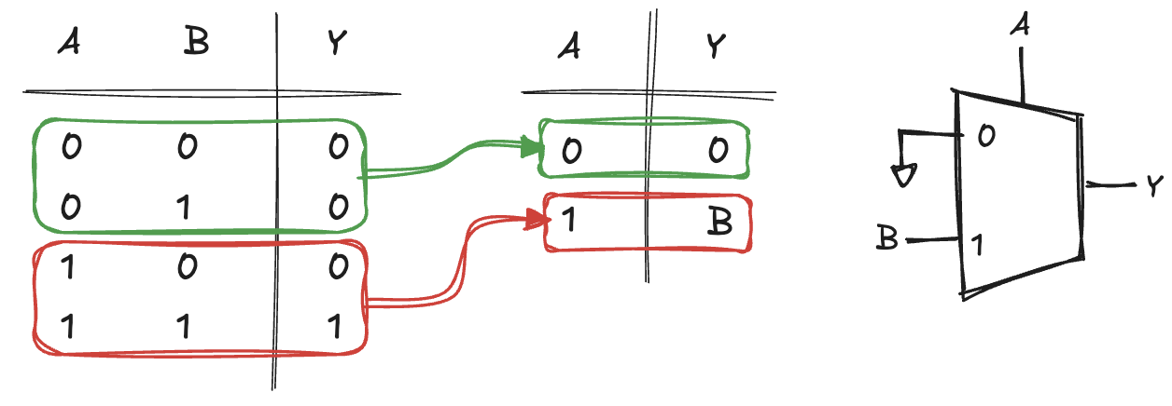
Multiplexer Logic (1)
Multiplexers can be used as lookup tables to perform logic functions
For example, we can implement a two-input AND gate
A and B serve as select lines
inputs are connected to 0 or 1, according to the corresponding row of the truth table
changing the data inputs, the multiplexer can be reprogrammed to perform a different function
In general, a 2^{N}-input multiplexer can be programmed to perform any N-input logic function by applying 0 and 1 to the appropriate data inputs
We can cut the multiplexer size in half, using only a 2^{N–1} input multiplexer to perform any N-input logic function
provide one of the literals to the multiplexer inputs:

Slide 8
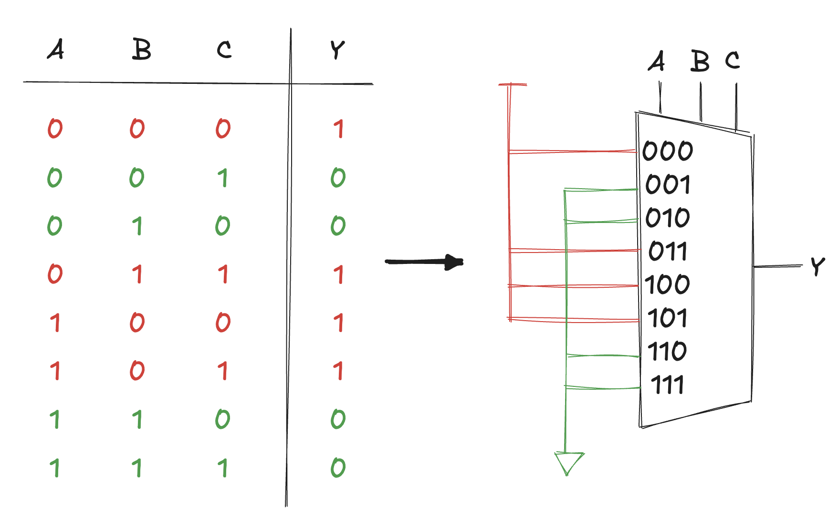
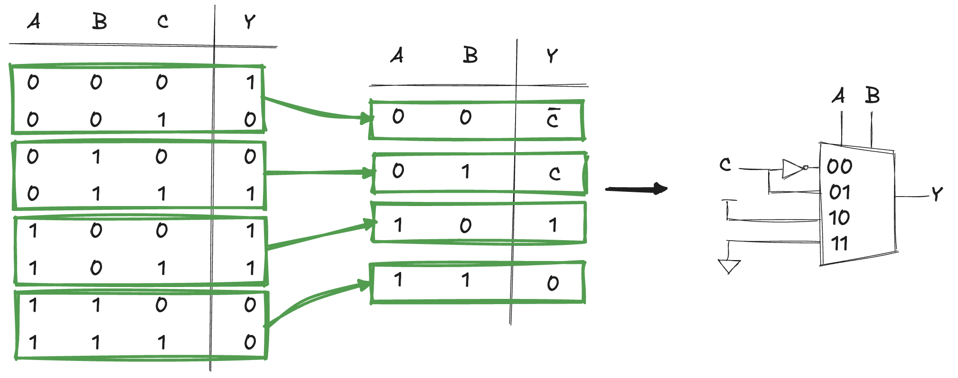
Multiplexer Logic (2)
As an example, implement the following function
using a 8:1 multiplexer
and a 4:1 multiplexer:

Slide 9
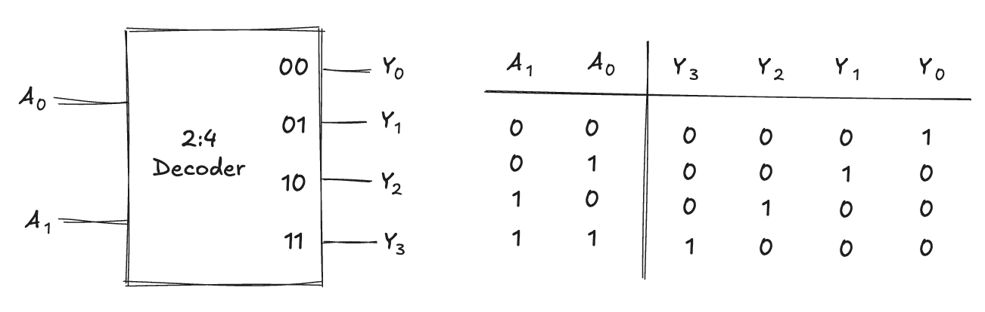
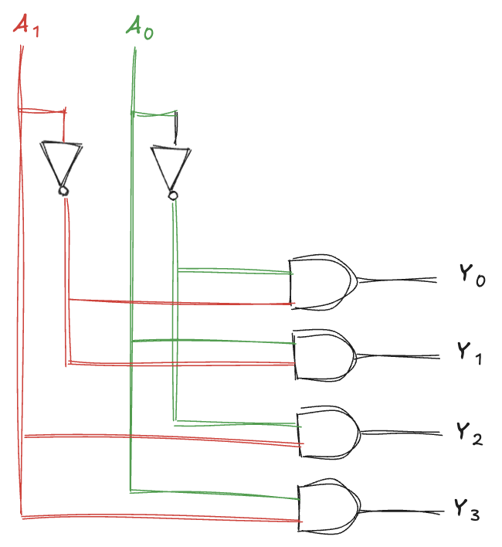
Decoder
A device with N inputs and 2^{N} outputs that asserts exactly one of its outputs depending on the input combination
For example, consider a 2:4 decoder
when A_{1:0} = 00, Y₀ is 1
when A_{1:0} = 01, Y₁ is 1
and so forth
The outputs are called one-hot, because just one is “hot” (HIGH) at a given time
In the implementation, each gate depends on either the true or the complementary form of each input
an N:2^{N} decoder can be constructed from 2^{N} N-input AND gates that accept the various combinations of true or complementary inputs
each output in a decoder represents a single minterm
for example, Y₃ represents the minterm A₁ A₀.

Slide 10
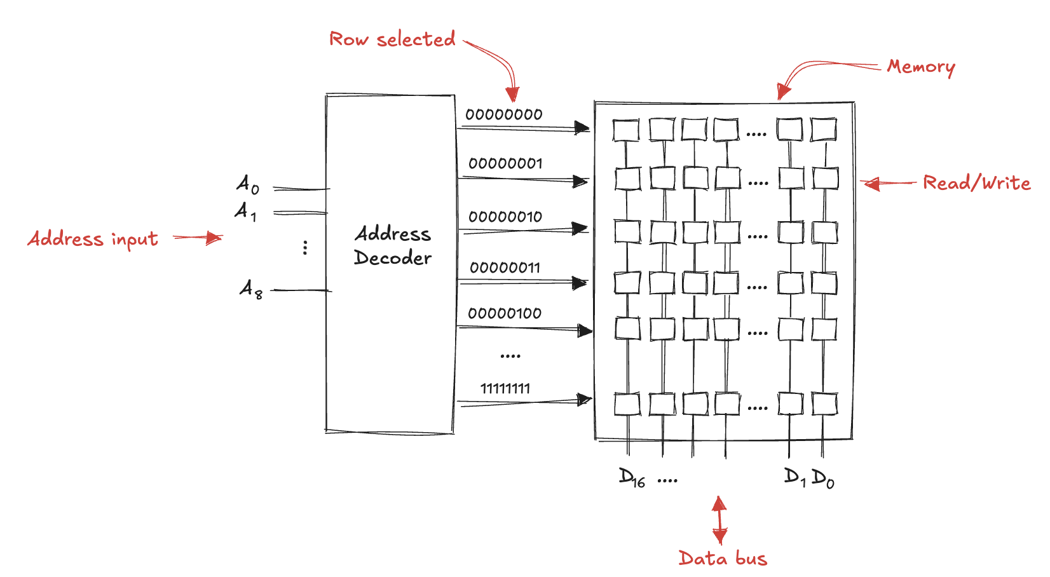
Decoder example
A decoder can be used to control which of several lines is “on” based on the binary value of the input. It can be used in memory address selection:

Slide 11
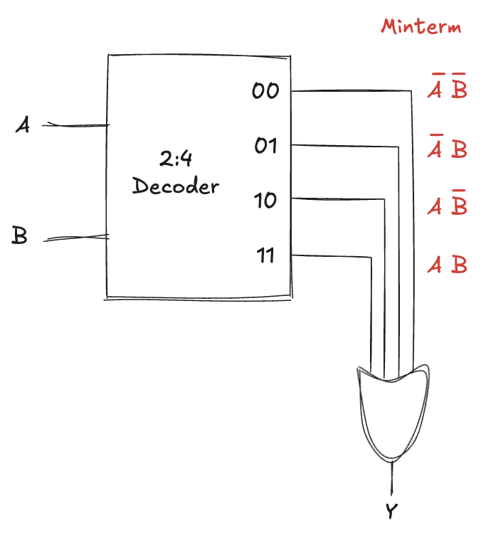
Decoder Logic
Decoders can be combined with OR gates to build logic functions
because each output of a decoder represents a single minterm, the function is built as the OR of all of the minterms in the function
example: a two-input XNOR function using a 2:4 decoder and a single OR gate
An N-input function with M 1s in the truth table can be built with an N:2N decoder and an M-input OR.

Slide 12
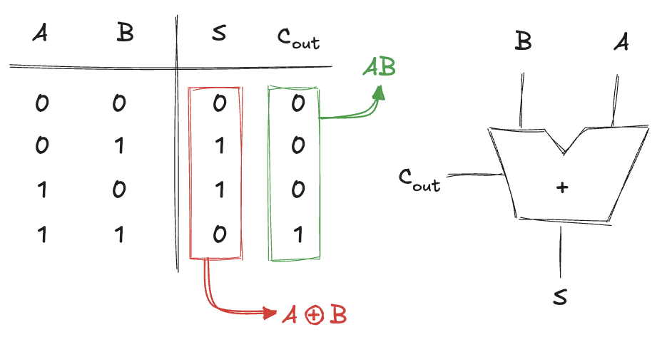
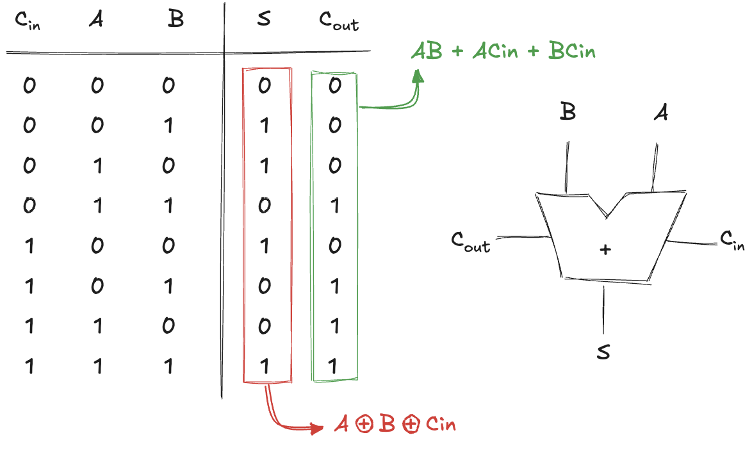
Half and Full Adders
Addition is one of the most common operations in digital systems
Half adder
two inputs, A and B, and two outputs, S and C_{out}
S is the sum of A and B
C_{out} is the eventual carry out
In a multi-bit adder, C_{out} is added (carried) in to the next most significant bit
half adder lacks a C_{in} input to accept the C_{out} of the previous column
Full Adder
accepts also the carry in C_{in}

Slide 13
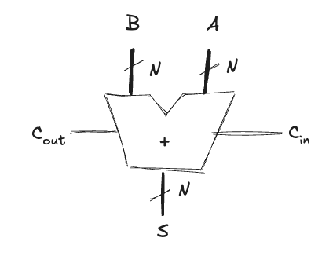
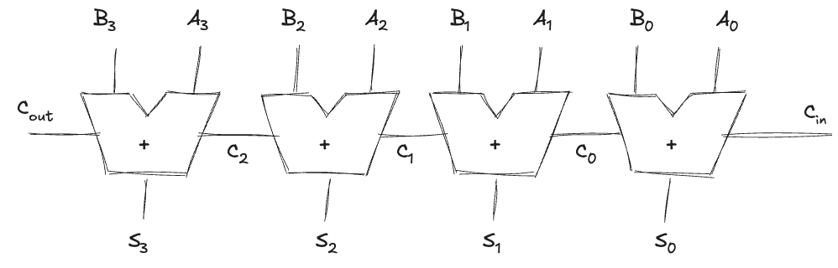
Carry Propagate Adder
A N-bit adder that sums two N-bit inputs and a carry-in to produce an N-bit result and a carry-out
the carry bit propagates into the adder
drawn like a full adder except that input/output are busses rather than single bits
Simplest way to build: chain together N full adders (Ripple-Carry Adder RCA)
C_{ouy} of one stage acts as the C_{in} of the next stage
A good application of modularity and regularity
full adder module is reused many times to form a larger system
It is slow when N is large.
S₃ depends on C₂, which depends on C₁, and so forth
the delay of the adder t_{riple} = N * t_{FA} grows directly with the number of bits

Slide 14
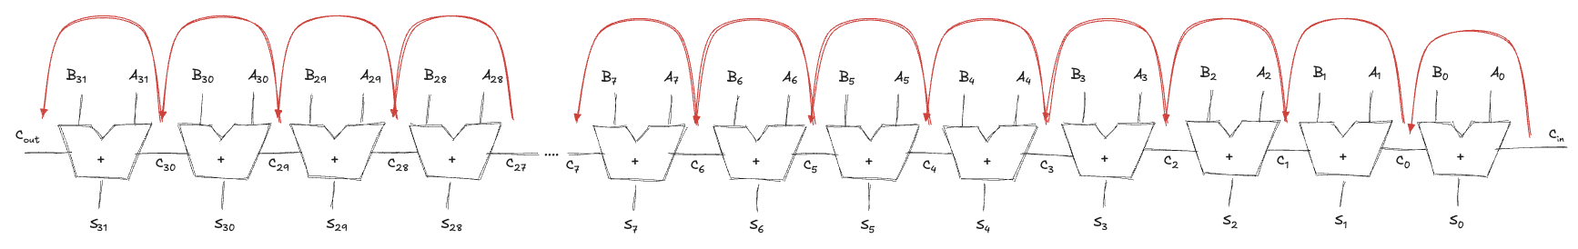
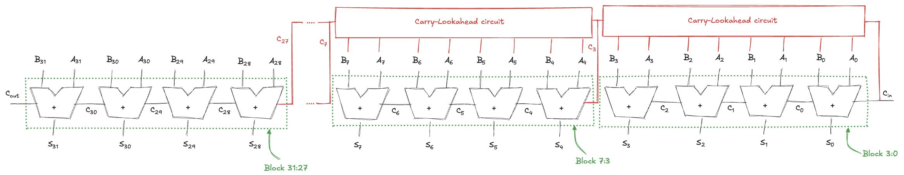
Carry-Lookahead Adder (1)
RCA are slow because the carry must propagate:
The idea is to divide the adder into blocks and determine the carry out of a block as soon as the carry in is known
it looks ahead across the blocks rather than wait to ripple through all the full adders

Slide 15
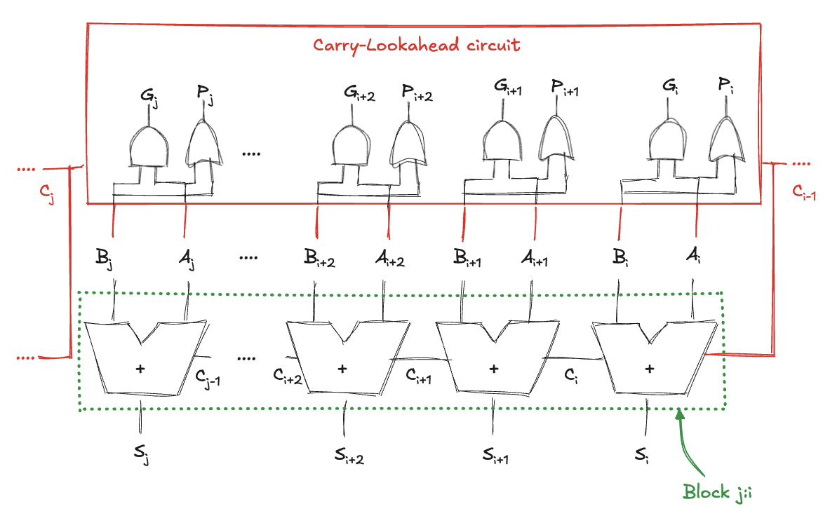
Carry-Lookahead Adder (2)
Carry-Lookahead Adder CLA use generate (G) and propagate (P) signals
A column “generates” a carry if it produces a carry independent of its carry-in
both input are 1 -> G_{i} = A_{i} AND B_{i}
A column “propagates” a carry if it produces a carry whenever there is a carry-in
either one of the input is 1 -> P_{i} = A_{i} OR B_{i}

Slide 16
Carry-Lookahead Adder (2)
We can extend to multiple-bit blocks
a block “generates” a carry if it produces a carry out independent of the carry-in
a block “propagate” a carry if it produces a carry out whenever there is a carry-in
A block j:i (spanning columns i through j) generates a carry
if the most significant column generates a carry
if the previous column generated a carry and the most significant column propagates it
and so forth
G_{j:i} = G_{j} + P_{j}(G_{j-1} + P_{j-1} (G_{j-2} + P_{j-2} ( …. (G_{i+2} + P_{i+2}(G_{i+1} + P_{i+1}G_{i}))
e.g. G_{7:4} = G₇ + P₇(G₆ + P₆(G₅ + P₅G₄)
A block i:j propagates a carry
if all the columns in the block propagate the carry
P_{j:i} = P_{j}P_{j-1}P_{j-2}…P_{i+2} P_{i+1} P_{i}
e.g. P_{3:0} = P₃P₂P₁P₀
So, we can quickly compute the carry out of the block
C_{j} = G_{j:i} + P_{j:i}C_{i-1}

Slide 17
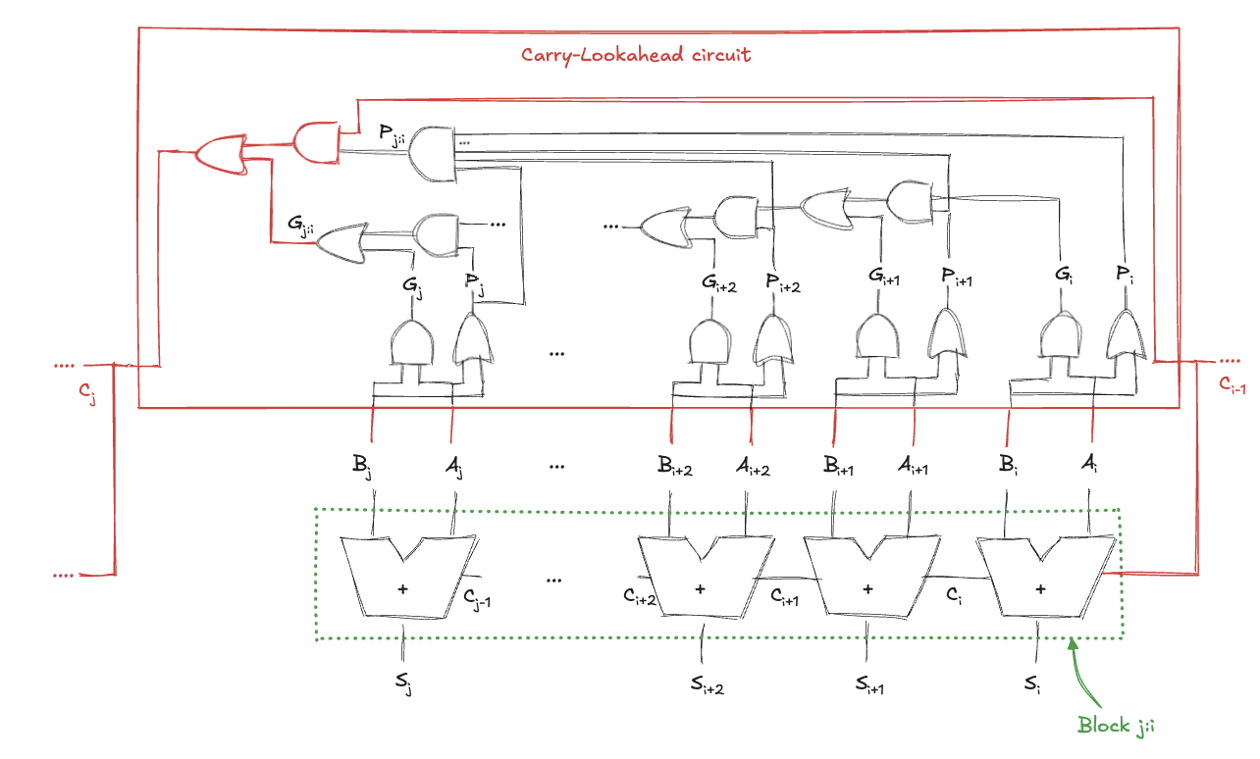
Carry-Lookahead Adder (3)

Slide 18
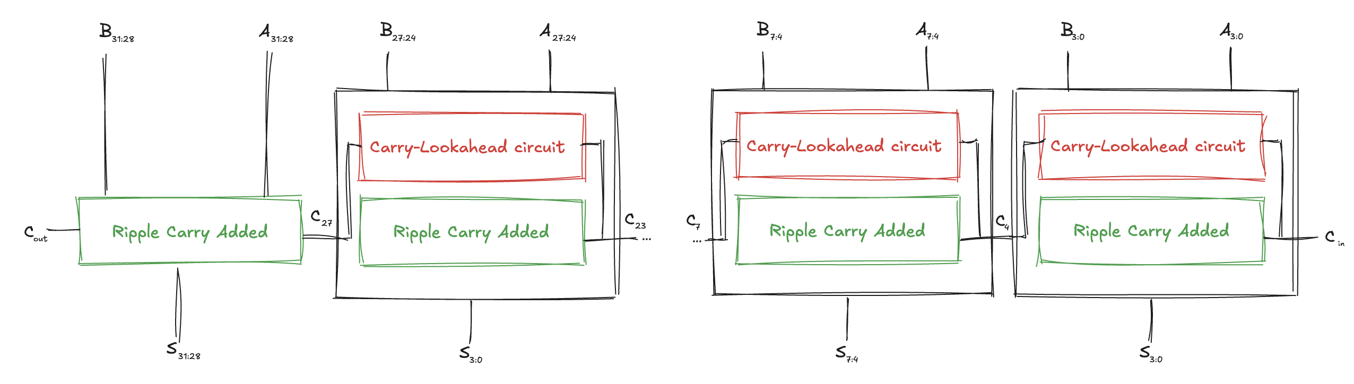
Carry-Lookahead Adder (4)
A 32-bit carry-lookahead adder composed of eight 4-bit blocks:
Each block contains a 4-bit ripple-carry adder and the lookahead circuit to compute the carry out of the block given the carry-in
All blocks compute column generate and propagate signals simultaneously
Then C_{in} advances to C_{out} through each block until the last
C_{in} proceeds through the lookahead gates to produce C₃
C₃ proceeds through its lookahead block to produce C₇
C₇ proceeds through its lookahead block to produce C₁₁
and so on until C₂₇, the carry-in to the last block
The last block contains a short ripple-carry adder (no more the lookahead logic)

Slide 19
Carry-Lookahead Adder delay
An N-bit adder divided into k-bit blocks has a delay
t_{pg} is the delay to generate signals P_{i} and G_{i}
t_{pg_block} is the delay to to generate signals P_{j:i} and G_{j:i} for a k-bit block
t_{lookahead} is the delay from C_{in} to C_{out} through the logic of the k-bit CLA block
t_{CLA} = t_{pg} + t_{pg_block} + (N/k -1) t_{lookahead} + k t_{FA}
For N > 16, the carry-lookahead adder is much faster than the ripple-carry adder
however, the adder delay still increases linearly with N
Faster adders require more hardware and therefore are more expensive and power-hungry
these trade-offs must be considered when choosing an appropriate adder for a design

Slide 20
Ripple-Carry Adder vs Carry-Lookahead Adder
Compare the delays of a 32-bit ripple-carry adder and a 32-bit carry-lookahead adder with 4-bit blocks
Assume that each gate delay is 100ps and that a full adder delay is 300ps
The propagation delay of the 32-bit ripple-carry adder is
t_{riple} = N * T_{FA} = 32 * 300ps = 9.6 ns
The carry-lookahead adder has
t_{pg} = 100ps (one AND or one OR)
t_{pg_block} = 6 * 100 ps = 600ps (six AND/OR gates)
t_{lookahead} = 2 * 100 ps = 200ps (one OR and one AND)
t_{CLA}=t_{pg}+t_{pg_block}+(N/k-1)t_{lookahead}+kt_{FA} = 100 + 600 + (32/4 - 1)*200 + 4*300 = 3.3ns
The carry-lookahead adder is almost 3 times faster than the ripple-carry adder

Slide 21
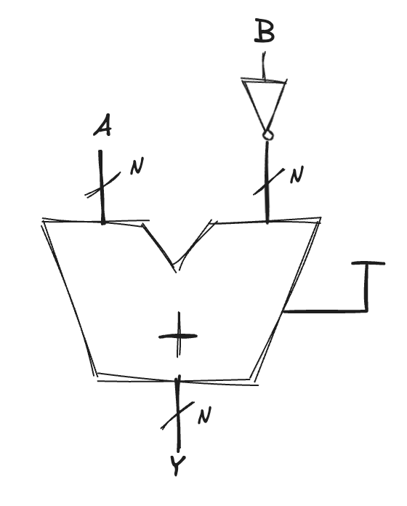
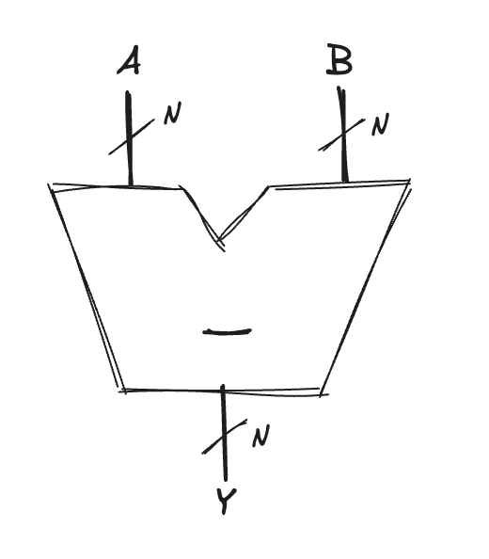
Subtractor
Performed by taking the two’s complement of the second number, then adding
To compute Y = A − B
first create the two’s complement of B
invert the bits of B to obtain B
add 1 to get −B = B + 1
add this quantity to A
Y = A + B + 1 = A − B
We can use a single carry-lookahead adder by adding A + B with C_{in} = 1

Slide 22
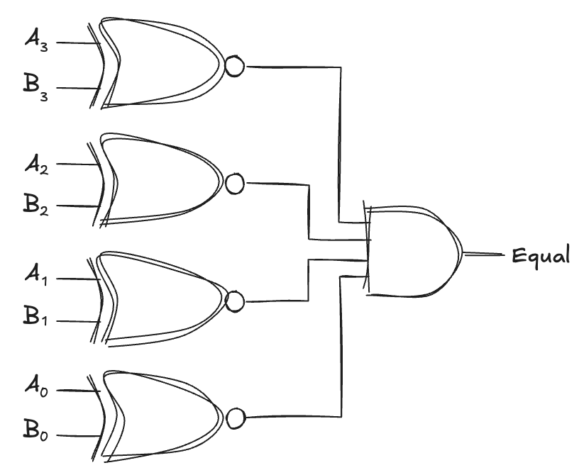
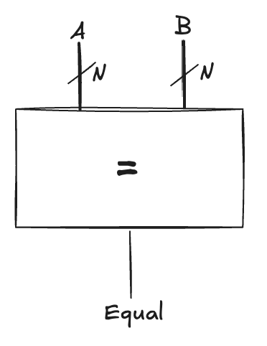
Comparators (1)
Determines whether two binary numbers are equal or if one is greater or less than the other
receives two N-bit binary numbers A and B
an equality comparator produces a single output, indicating A is equal to B
a magnitude comparator produces one or more outputs, indicating the relative values of A and B
The equality comparator is the simpler piece of hardware
it checks whether the corresponding bits in each column of A and B are equal
using XNOR gates
the numbers are equal if all the columns are equal

Slide 23
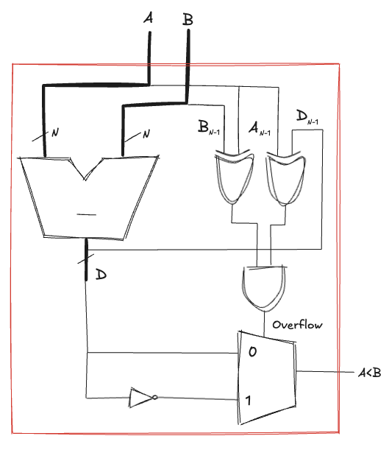
Comparators (2)
Magnitude comparison of signed numbers is usually done by computing A − B and looking at the sign (most significant bit) of the result
if the result is negative (i.e., the sign bit is 1), then A is less than B
otherwise, A is greater than or equal to B
This comparator functions incorrectly upon overflow
overflow occurs when
the two inputs have different signs
and the sign of the subtraction result has a different sign than the A input

Slide 24
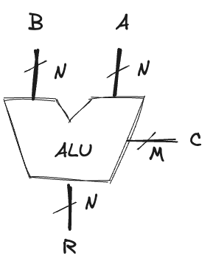
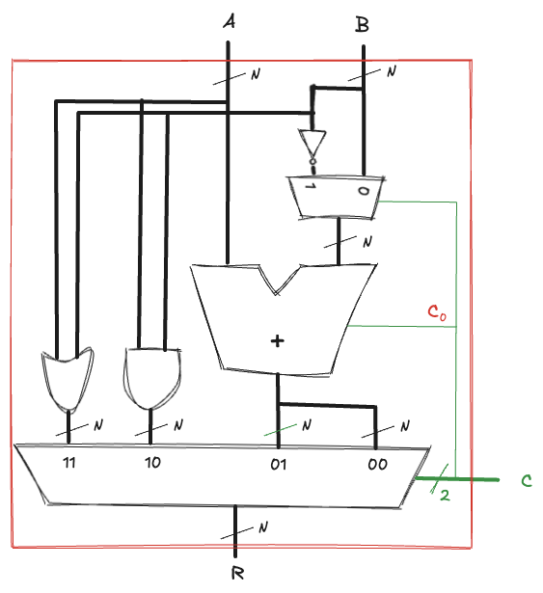
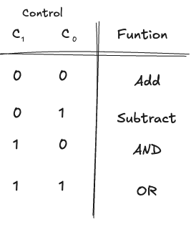
Arithmetic/Logical Unit (1)
ALU combines a variety of mathematical and logical operations into a single unit
addition, subtraction, AND, and OR operations
control signal to specifies the function to perform
the heart of most computer systems
The following implementation contains
an N-bit adder, N 2-input AND and OR gates

Slide 25
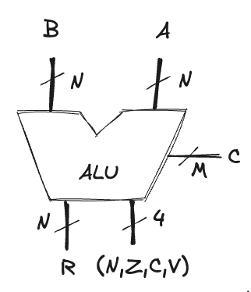
Arithmetic/Logical Unit (2)
ALU can produce flags to provide information about the result
Z (zero)
all the bits of the output are 0
N (negative)
the most significant bit of the output
C (carry)
adder produces a carry out and the ALU is performing addition or subtraction
V (overflow)
overflow occurs when the addition of two same signed numbers produces a result with the opposite sign
ALU is performing addition or subtraction (C₁=0)
A and Sum have opposite signs
A and B have the same sign, and the adder is performing addition (C₀=0)
or A and B have opposite sign, and the adder is performing subtraction (C₀=1)

Slide 26
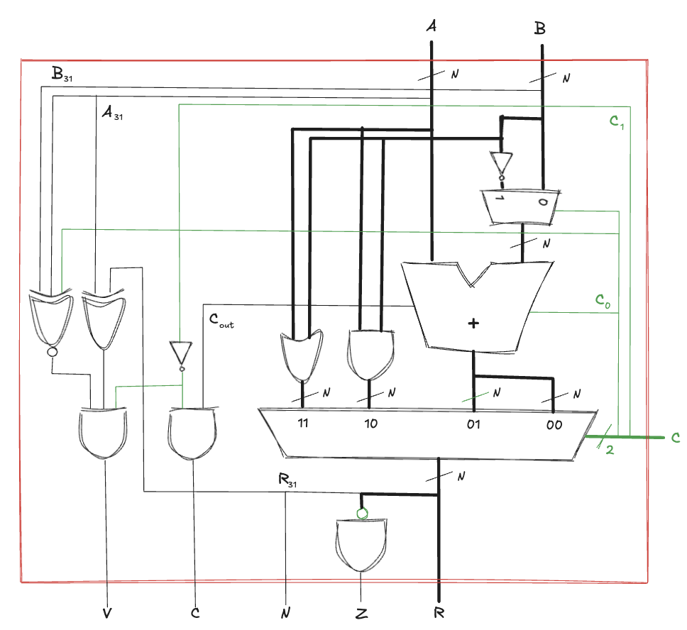
Arithmetic/Logical Unit (3)

Slide 27
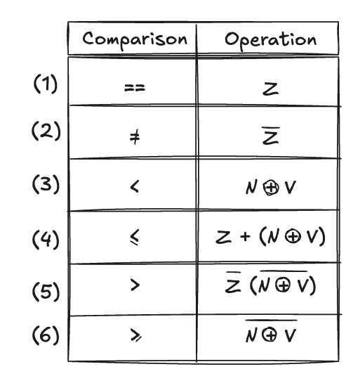
Arithmetic/Logical Unit (4)
The ALU flags can also be used for comparisons
ALU computes A-B and look at the flags:
(1) if Z is asserted, the result is 0, so A==B
(2) otherwise, A is not equal to B
(3) magnitude comparison is messier, we see whether the answer is negative (N). However, if overflow occurs, the N flag will be incorrect. Hence, A is less than B if the answer is negative and there is no overflow or if the answer is positive but overflow occurred
(4) A is less then or equal to B if occur the OR of condition (1) and (3)
(5) A is greater then B, if it is not less then or equal to B, the negation of condition (4)
(6) A is greater then or equal to B, if it is not less then B, the negation of condition (3)
Processors can use combinations of status bits for conditional branching (e.g., checking if a value is less than zero or within bounds)
Many variations on this basic ALU exist that support other functions

Slide 28
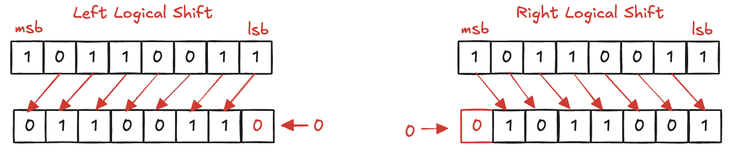
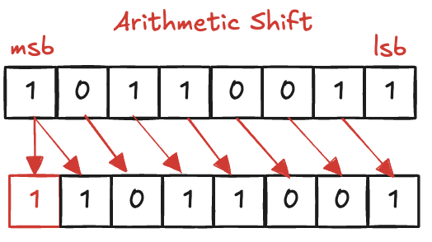
Shifters (1)
Shifters moves binary data, crucial in arithmetic operations, logical operations, and data manipulation. The main types are:
logical shifter: shifts all bits to the left (or right), inserting a 0 into lsb (or msb) and discarding msb (or lsb)
arithmetic shifter: like a logical shift with sign bit preserved if possible
A left shift by N bits multiplies the number by 2^{N}
000011₂ << 4 = 110000₂ is equivalent to 3₁₀ × 2⁴ = 48₁₀
A right shift by N bits multiplies the number by 2^{N}
11100₂ >>> 2 = 11111₂ is equivalent to −4₁₀/2² = −1₁₀

Slide 29
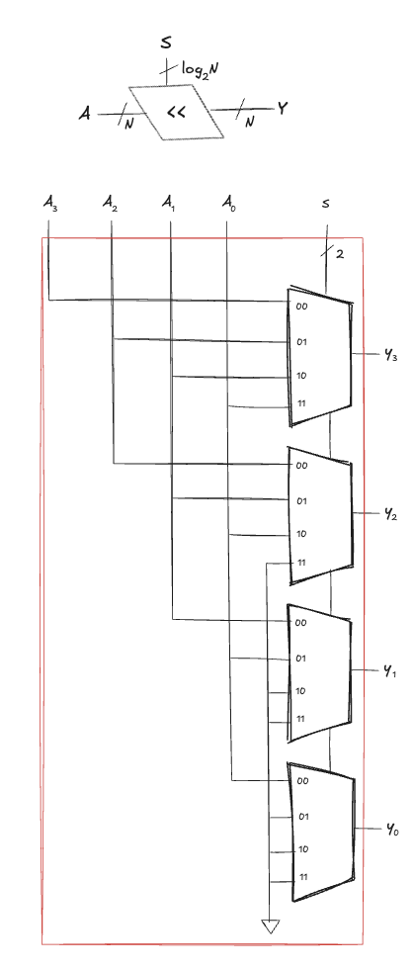
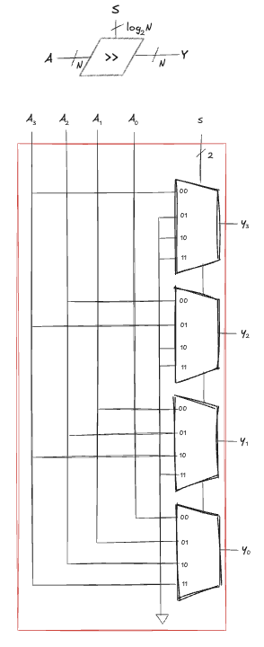
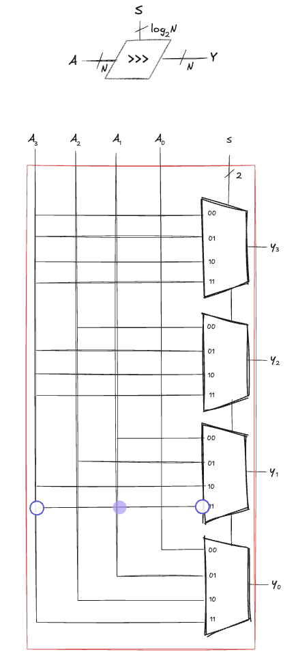
Shifters (2)
An N-bit shifter can be built from N N:1 multiplexers
Depending on the value of a log2(N)-bit shift amount control signal, the output receives the input shifted by 0 to N-1 bits

Slide 30
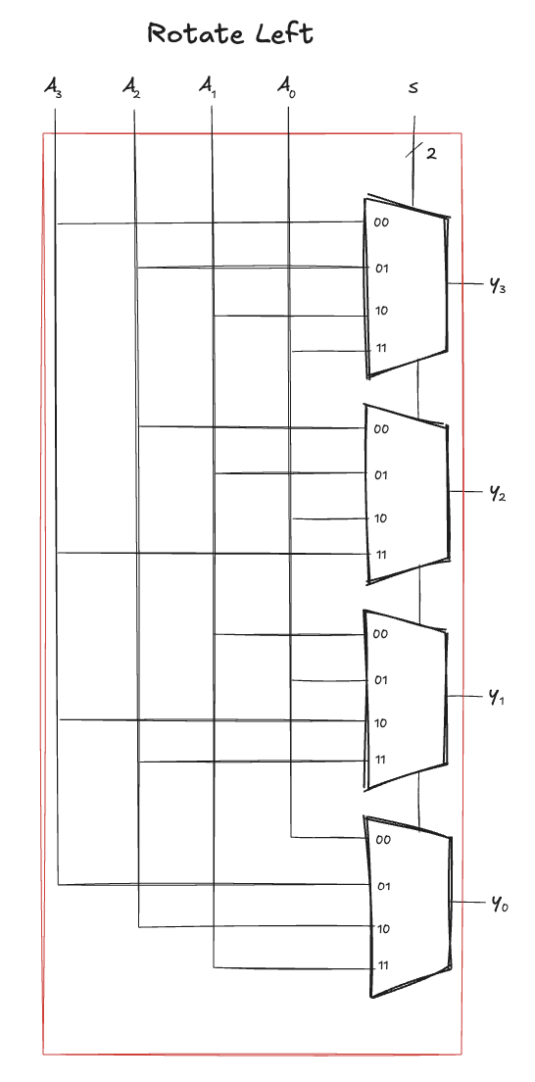
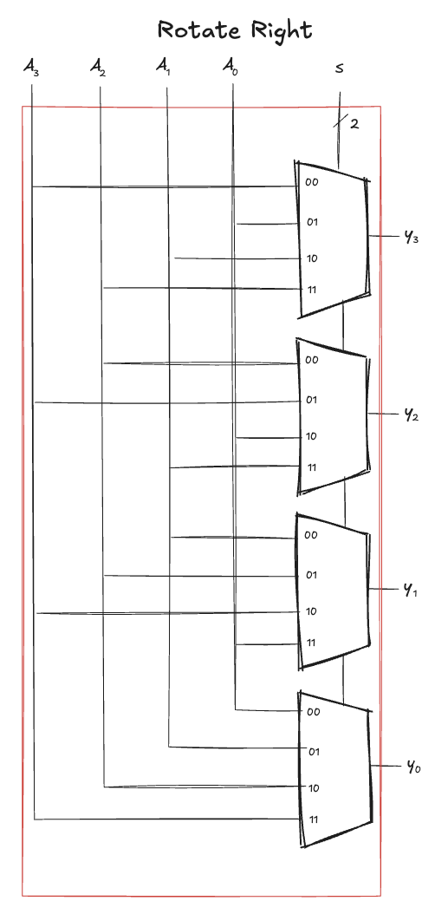
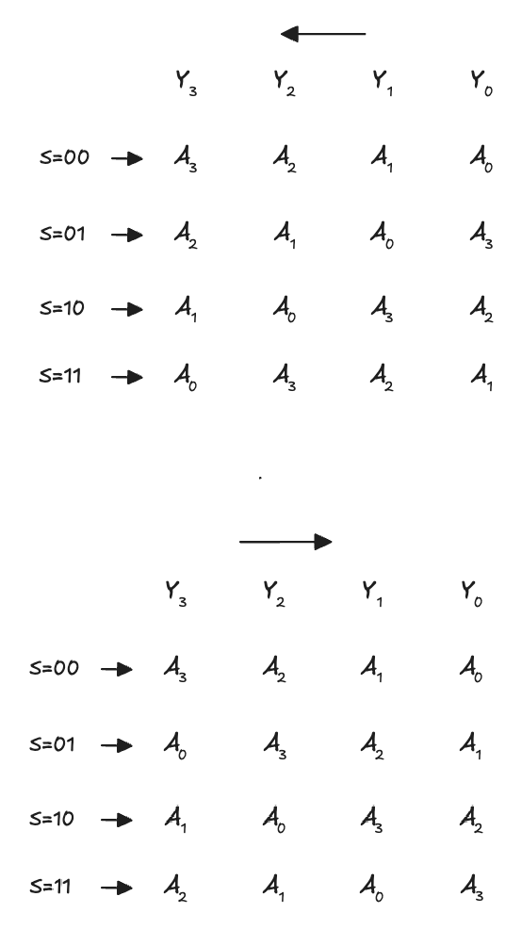
Rotators
Rotator rotates (left or right) a number in a circle such that empty spots are filled with bits shifted off the other end

Slide 31
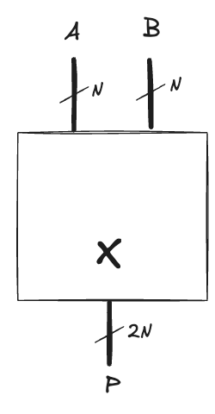
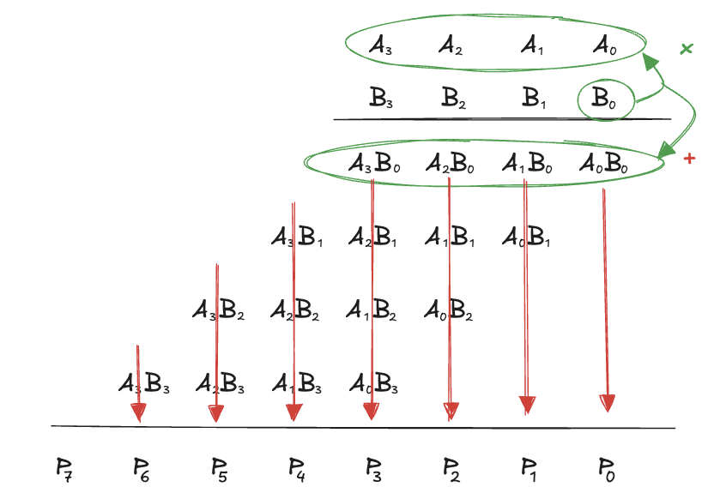
Multiplier (1)
Multiplication of 1-bit numbers is equivalent to the AND operation
A N×N multiplier produces a 2N-bit result
partial product is the AND of a single multiplier bit (B₃, B₂,…) with the multiplicand bits (A₃, A₂,…)
each partial products is added to the shifted next partial product
B₀ AND (A₃, A₂, A₁, A₀) is added to B₁ AND (A₃, A₂, A₁, A₀)
Considering an unsigned 4 × 4 multiplier

Slide 32
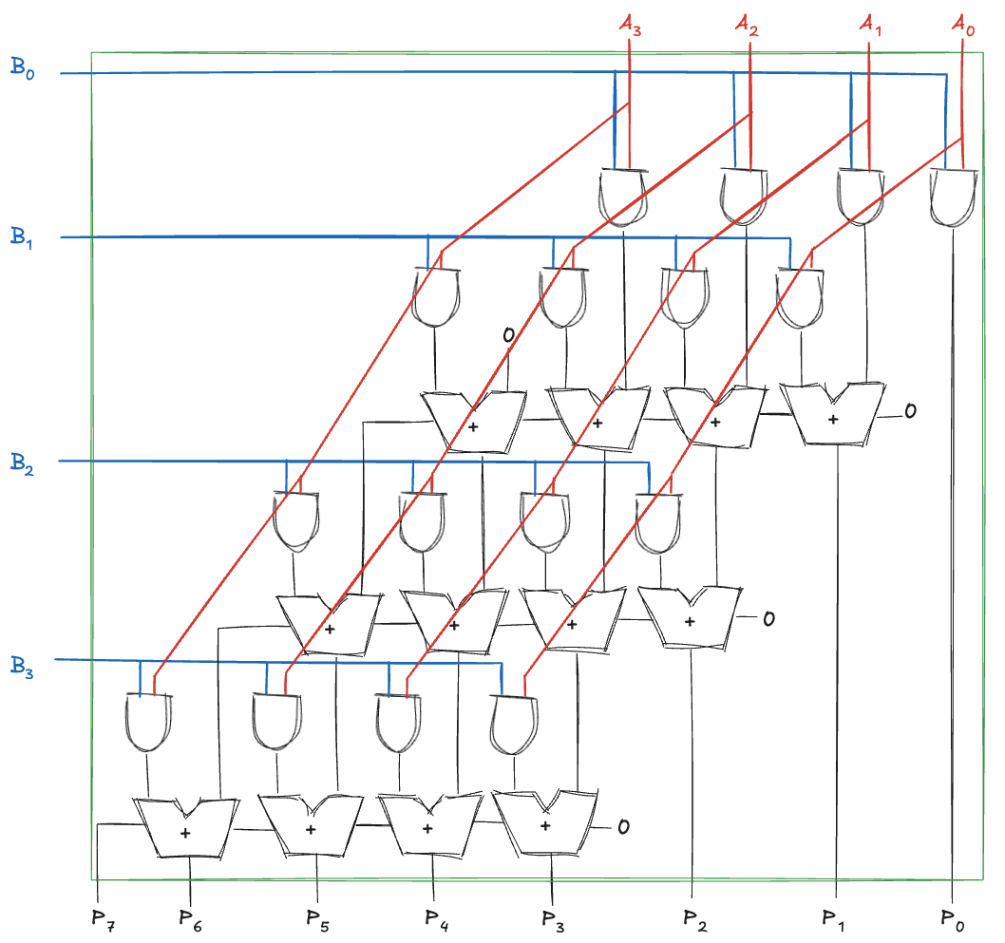
Multiplier (2)
Considering an unsigned 4 × 4 multiplier

Slide 33
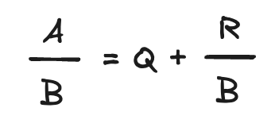
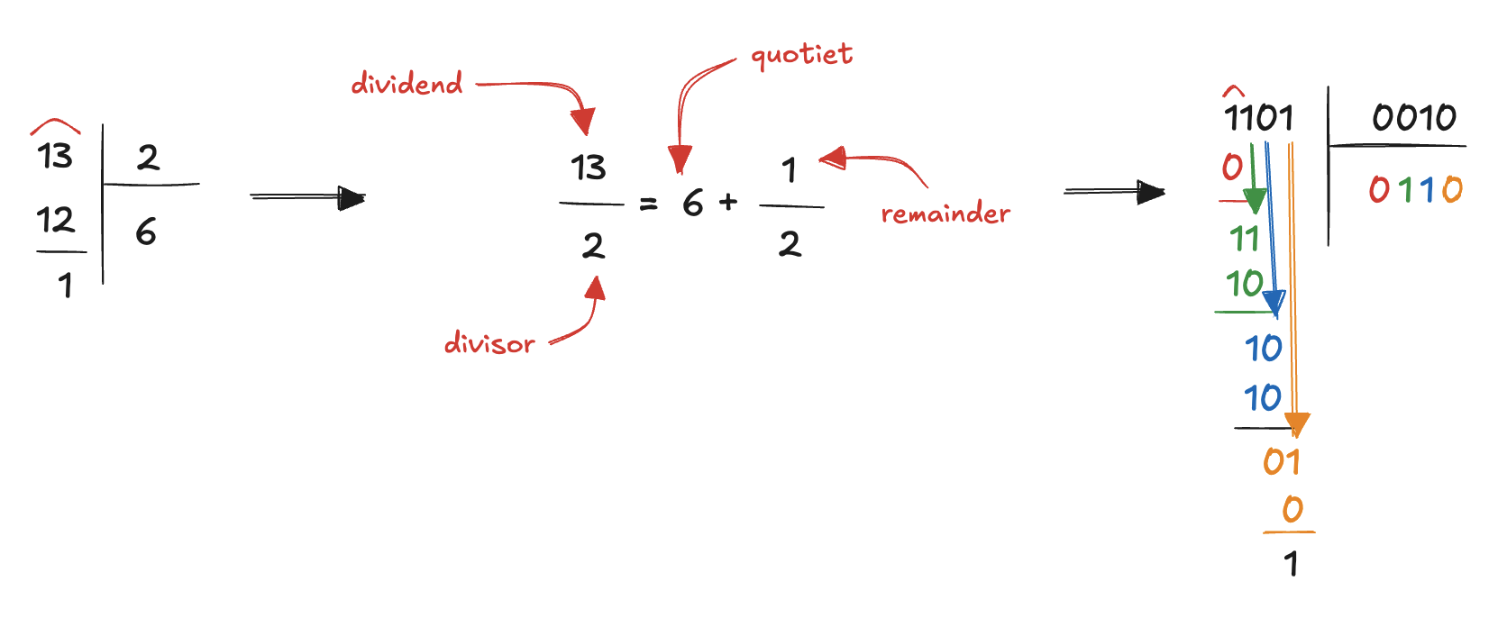
Division (1)
The most complex operation to perform among all the arithmetic operations
the basic idea is the same as long division in decimal
how many times the divisor can fit into sections of the dividend without exceeding it?
each time it fits, we add a 1 to the quotient
if it doesn’t fit, we add a 0
This is the restoring division algorithm

Slide 34
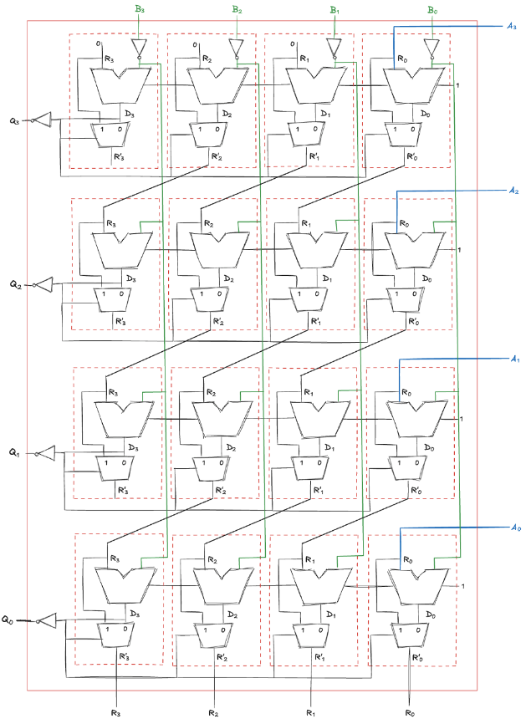
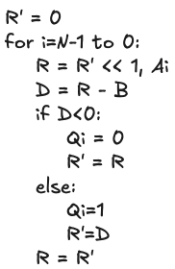

Division (2)

Slide 35


Floating-Point Addition (1)

Slide 36

Floating-Point Addition (2)
Floating-point arithmetic is usually done in hardware to make it fast
floating-point unit (FPU)
typically, distinct from the central processing unit (CPU)
The infamous floating-point division bug (1994)
the processor returns incorrect binary floating point results when dividing certain pairs of high-precision numbers…
missing values in a lookup table used by the FPU's division algorithm led to calculations acquiring small errors
these errors only occur rarely producing small deviations from the correct output
in certain circumstances the errors can occur frequently and lead to more significant deviations
Byte magazine estimated that 1 in 9 billion floating point divides with random parameters would produce inaccurate results
December 1994, Intel recalled the defective processors in what was the first full recall of a computer chip: it cost $475 million

Slide 37



Exercises (1)
Ex1: Implement the following function using (a) an 8:1 multiplexer, (b) a 4:1 multiplexer

Slide 38



Exercises (2)
Ex2: Implement the following function using (a) an 8:1 multiplexer, (b) a 4:1 multiplexer

